Slide 1

METAEDCATOR
HOSTING ON AWS
Amazon Web Service
WORDPRESS
www.metaeducators.com
YouTube Link : https://www.youtube.com/channel/UClqeB8qhY7k0Yaw6KIQI3dg
Instagram Link : https://www.instagram.com/metaeducator
Facebook : https://www.facebook.com/shubhanshunishad2221
Email : metaeducator@gmail.com

Slide 2

Create Your Free AWS Account

Slide 3

There are few steps to host your WORDPRESS website on AWS.

Slide 4
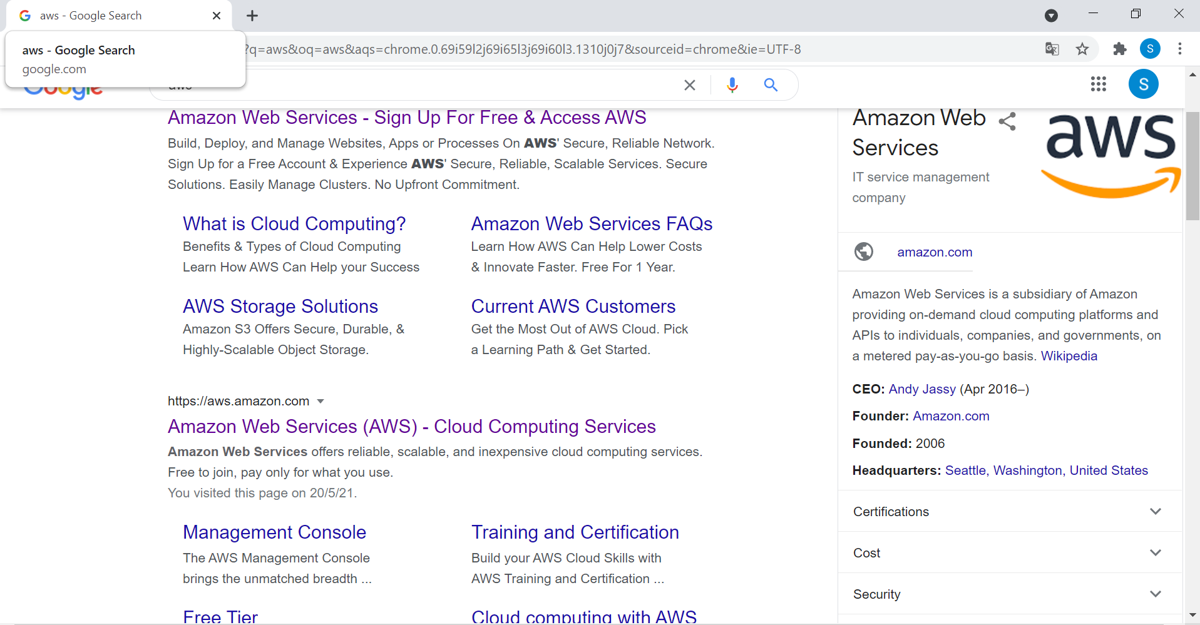
Click on
Aws ,
Login in
your
aws
account

Slide 5
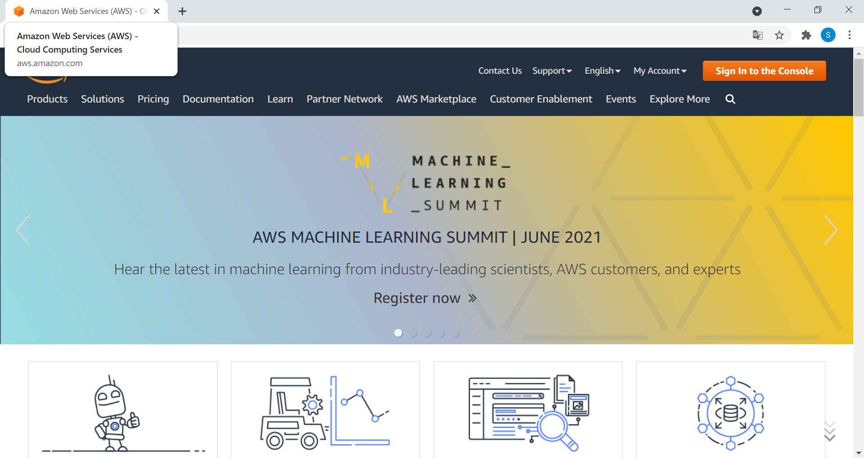
After Click On AWS Link , You have to login in your account

Slide 6
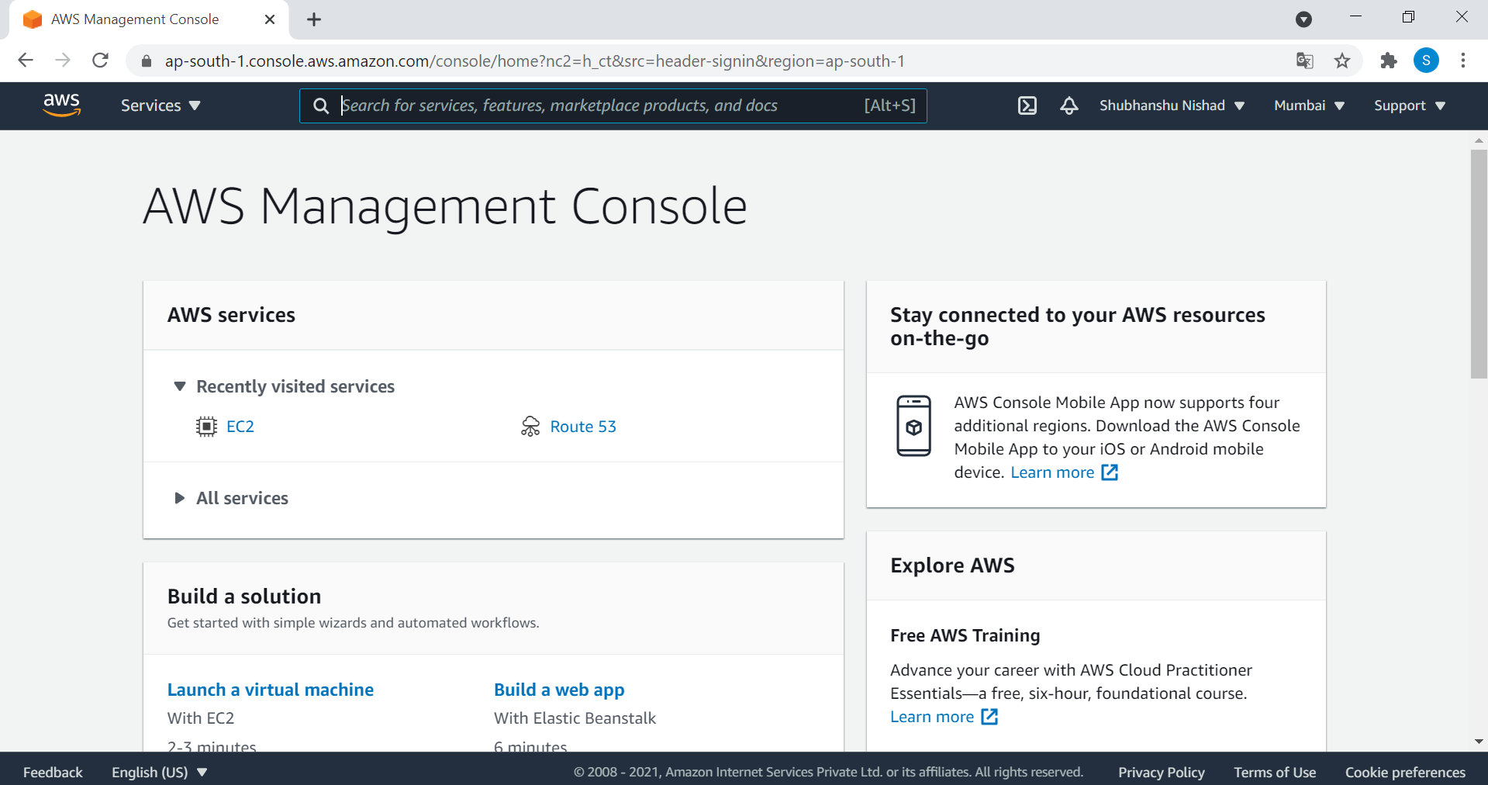
After sign-in, You are
able to see this page
Click Here :

Slide 7
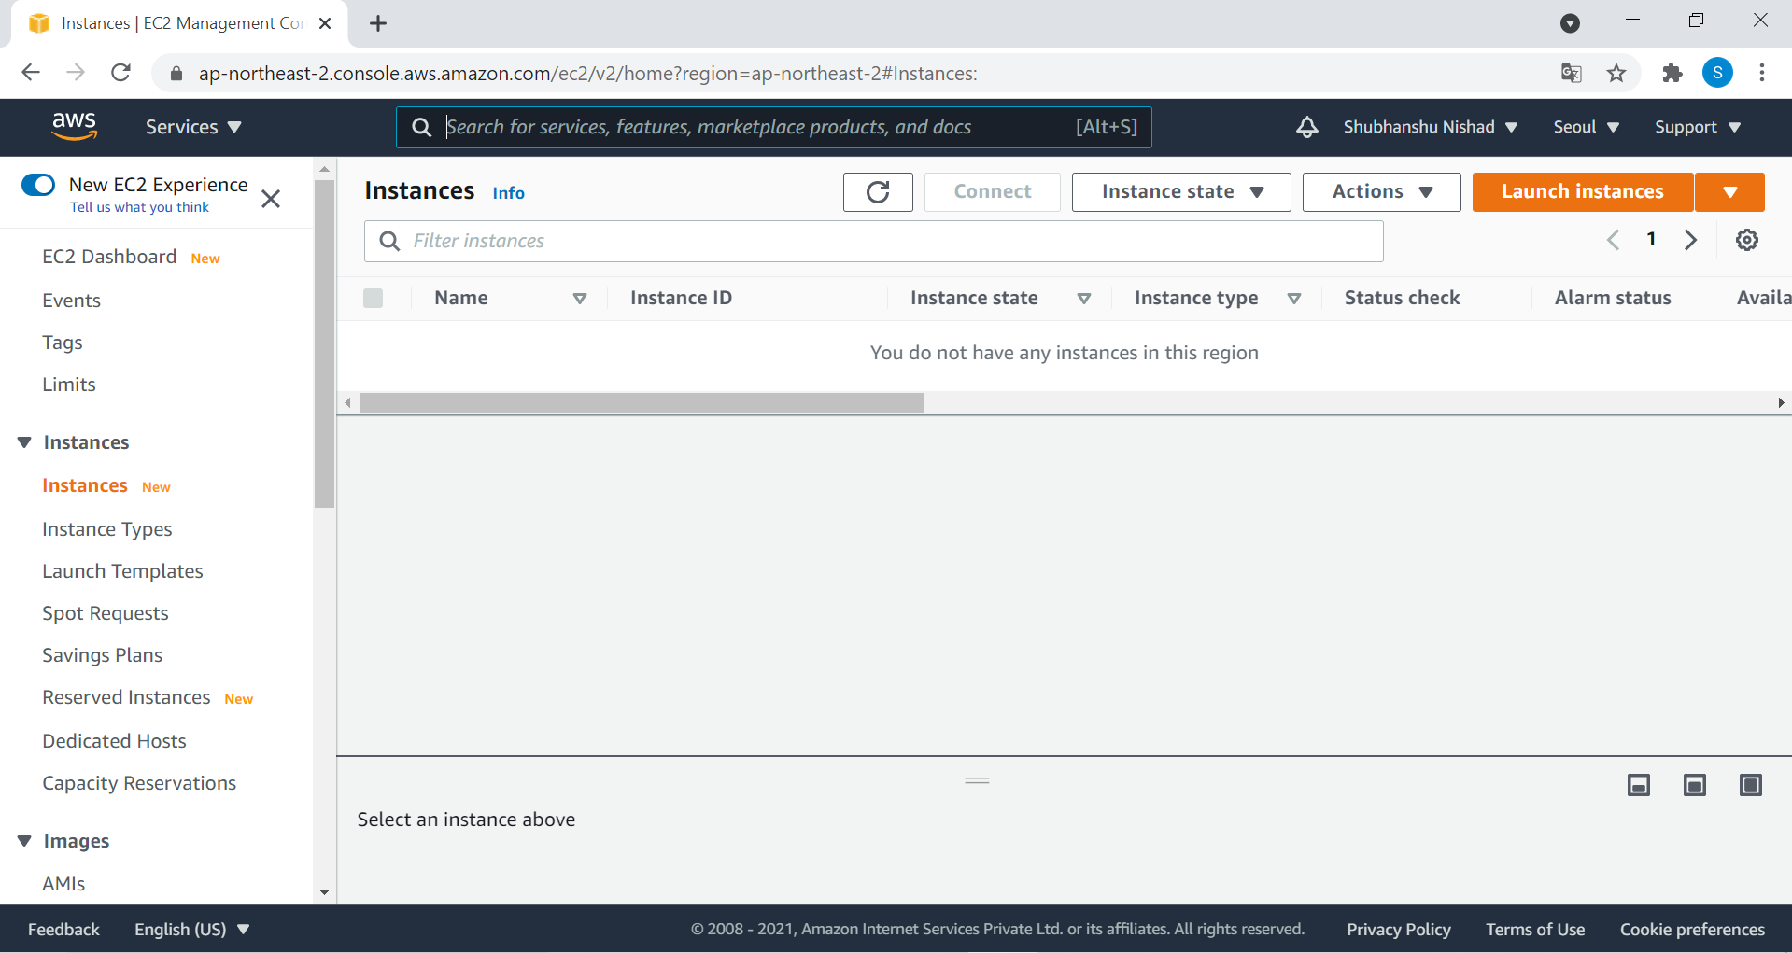
Click On Launch Instances
Now , You have to create Your Machine ,
where your wordpress website is hosted .

Slide 8
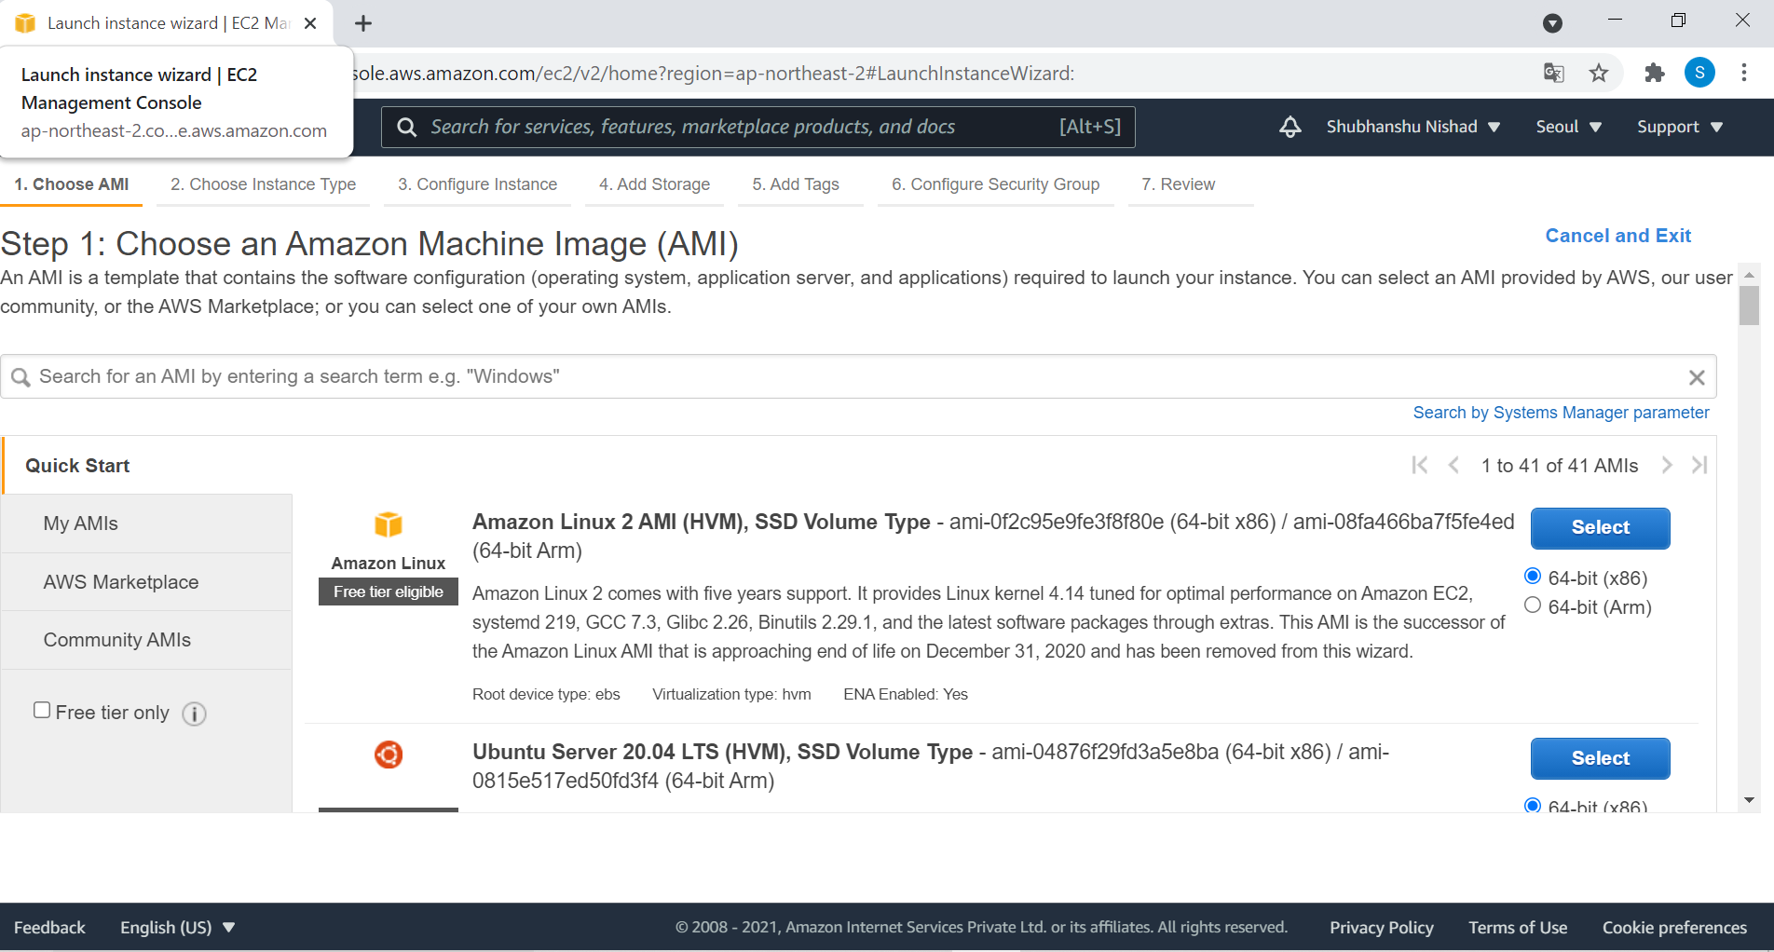
Now, You have to search WORDPRESS

Slide 9
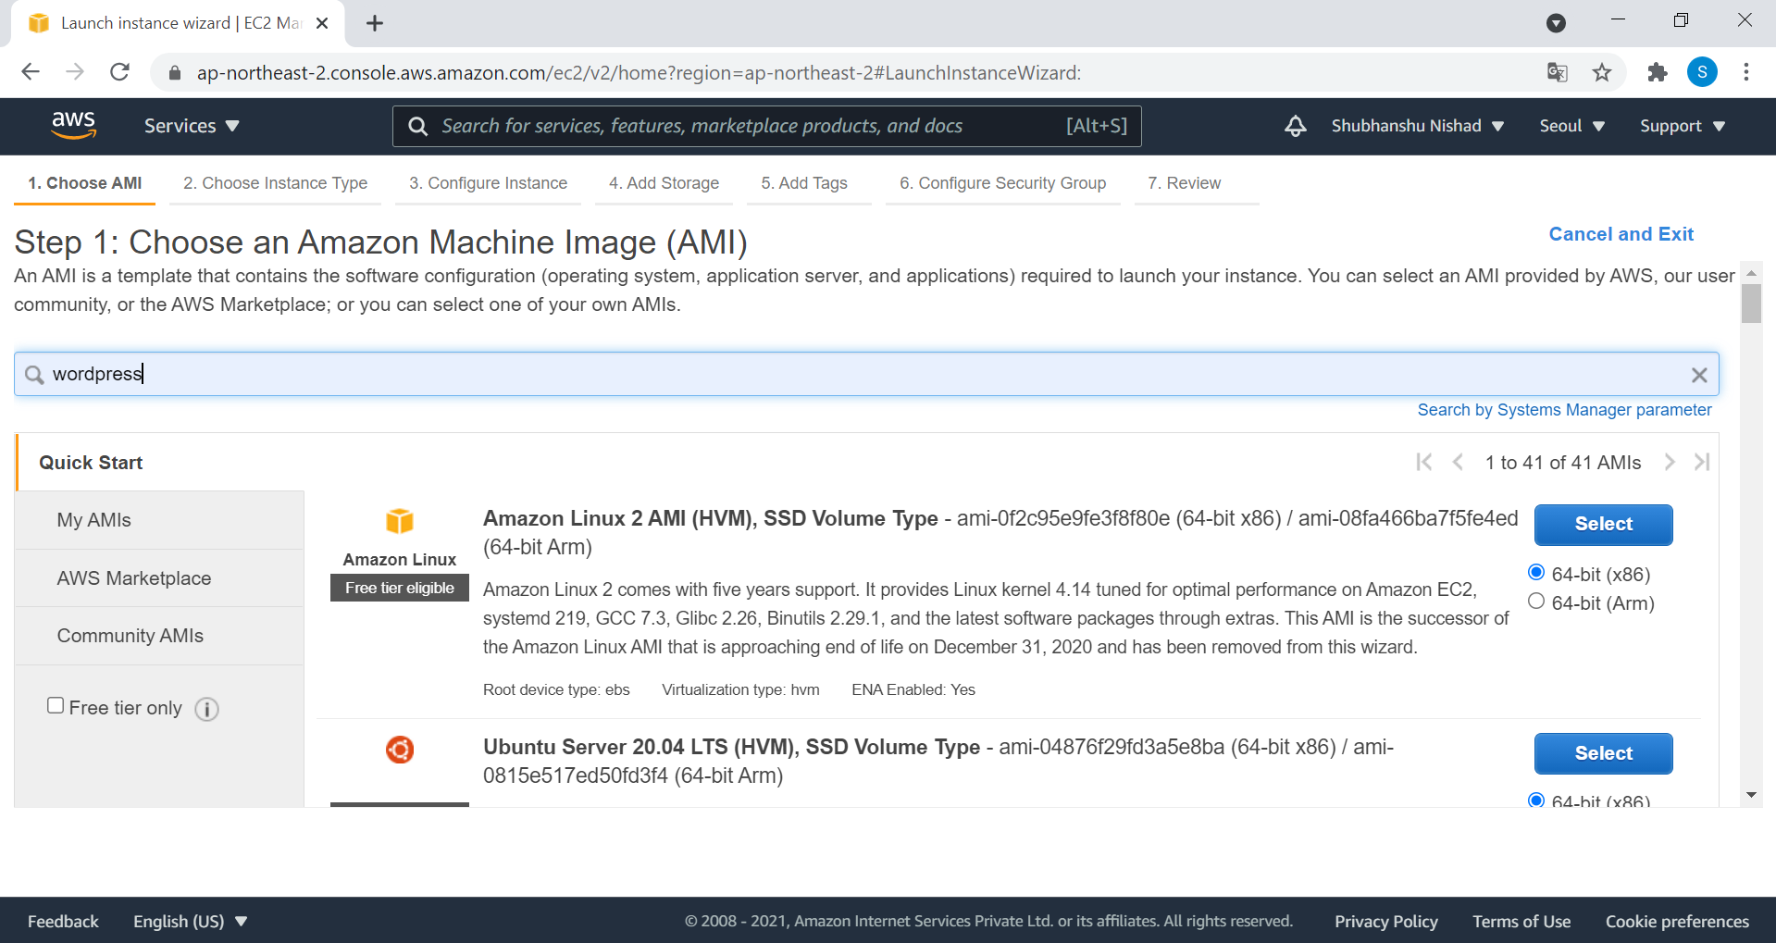
Press Enter Button

Slide 10
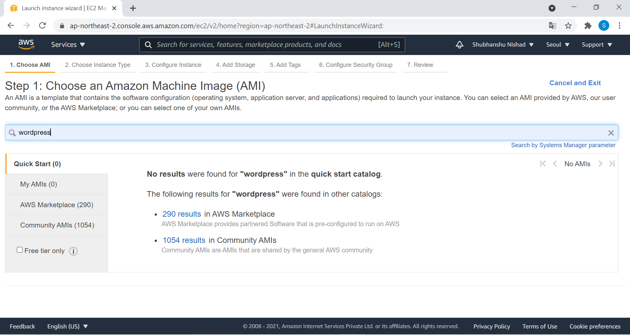
Click On this link .

Slide 11
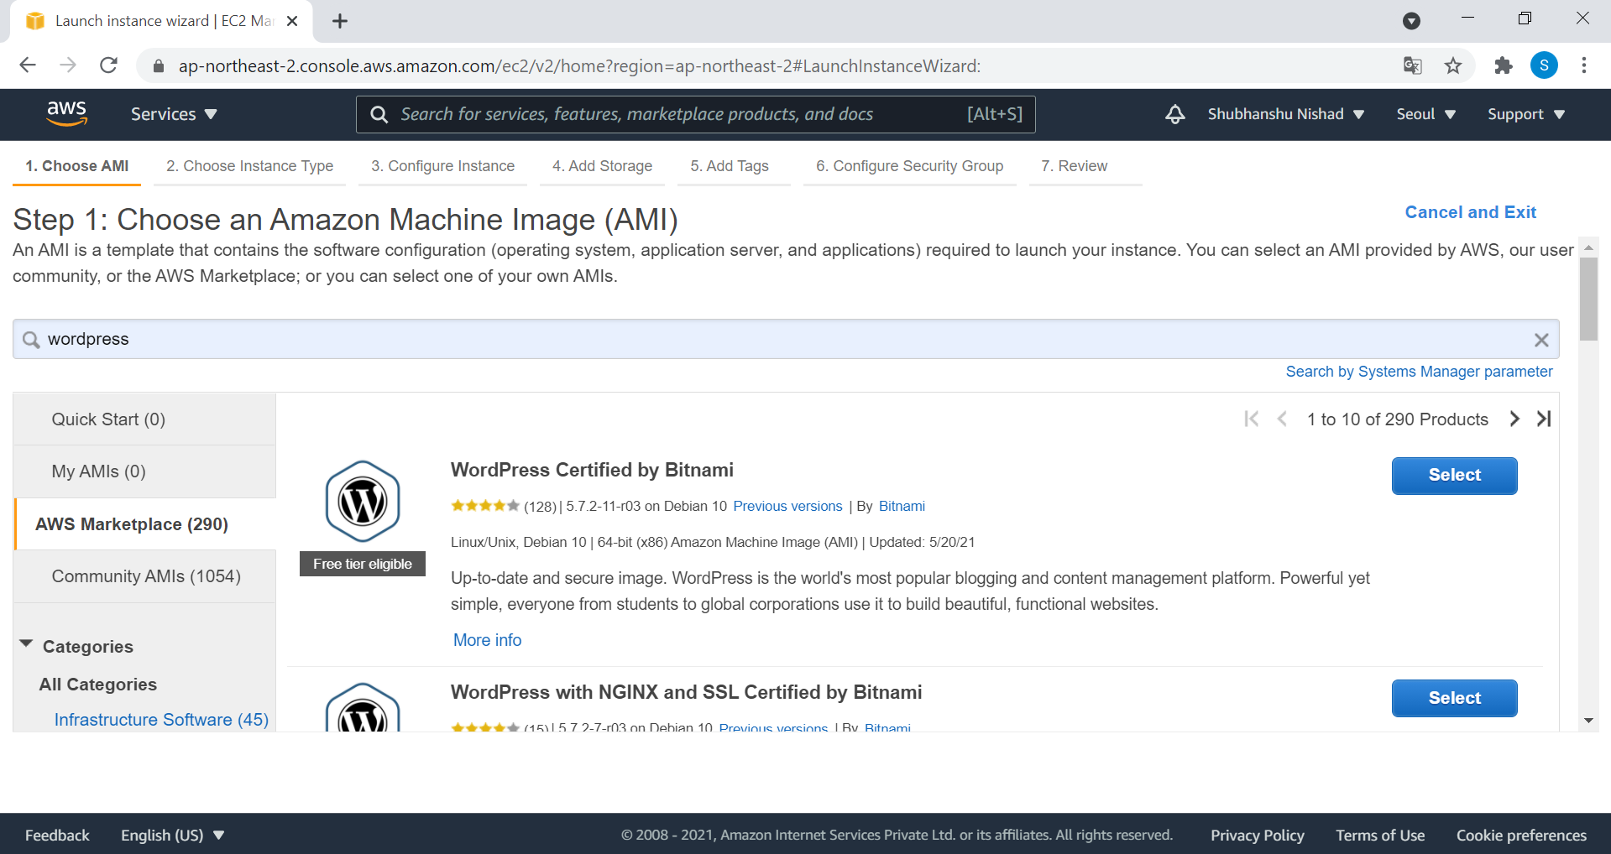
Select this Machine

Slide 12
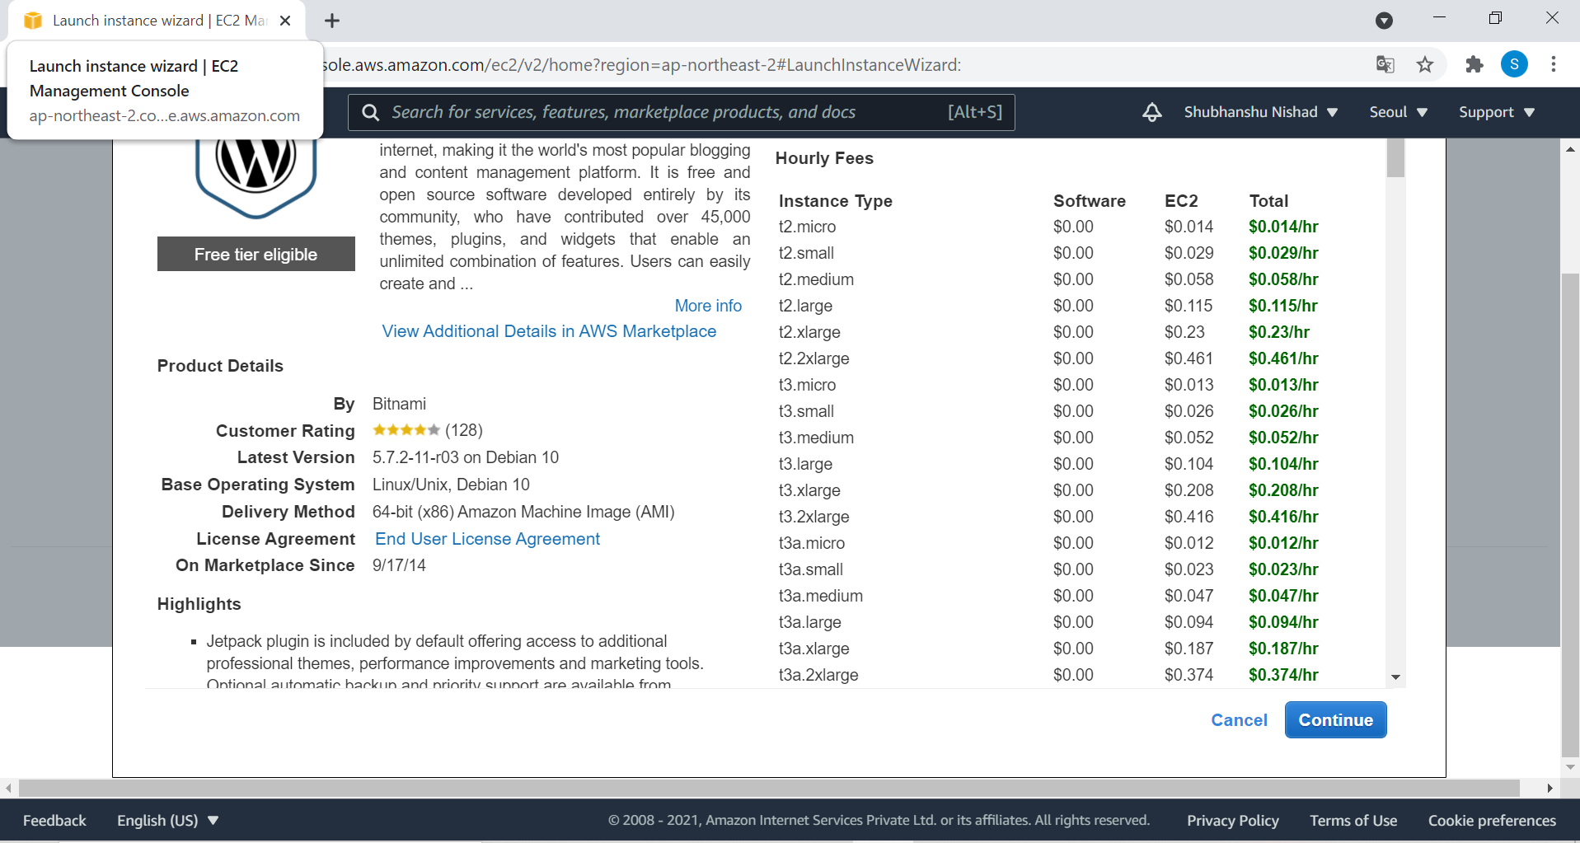
Click On Continue

Slide 13
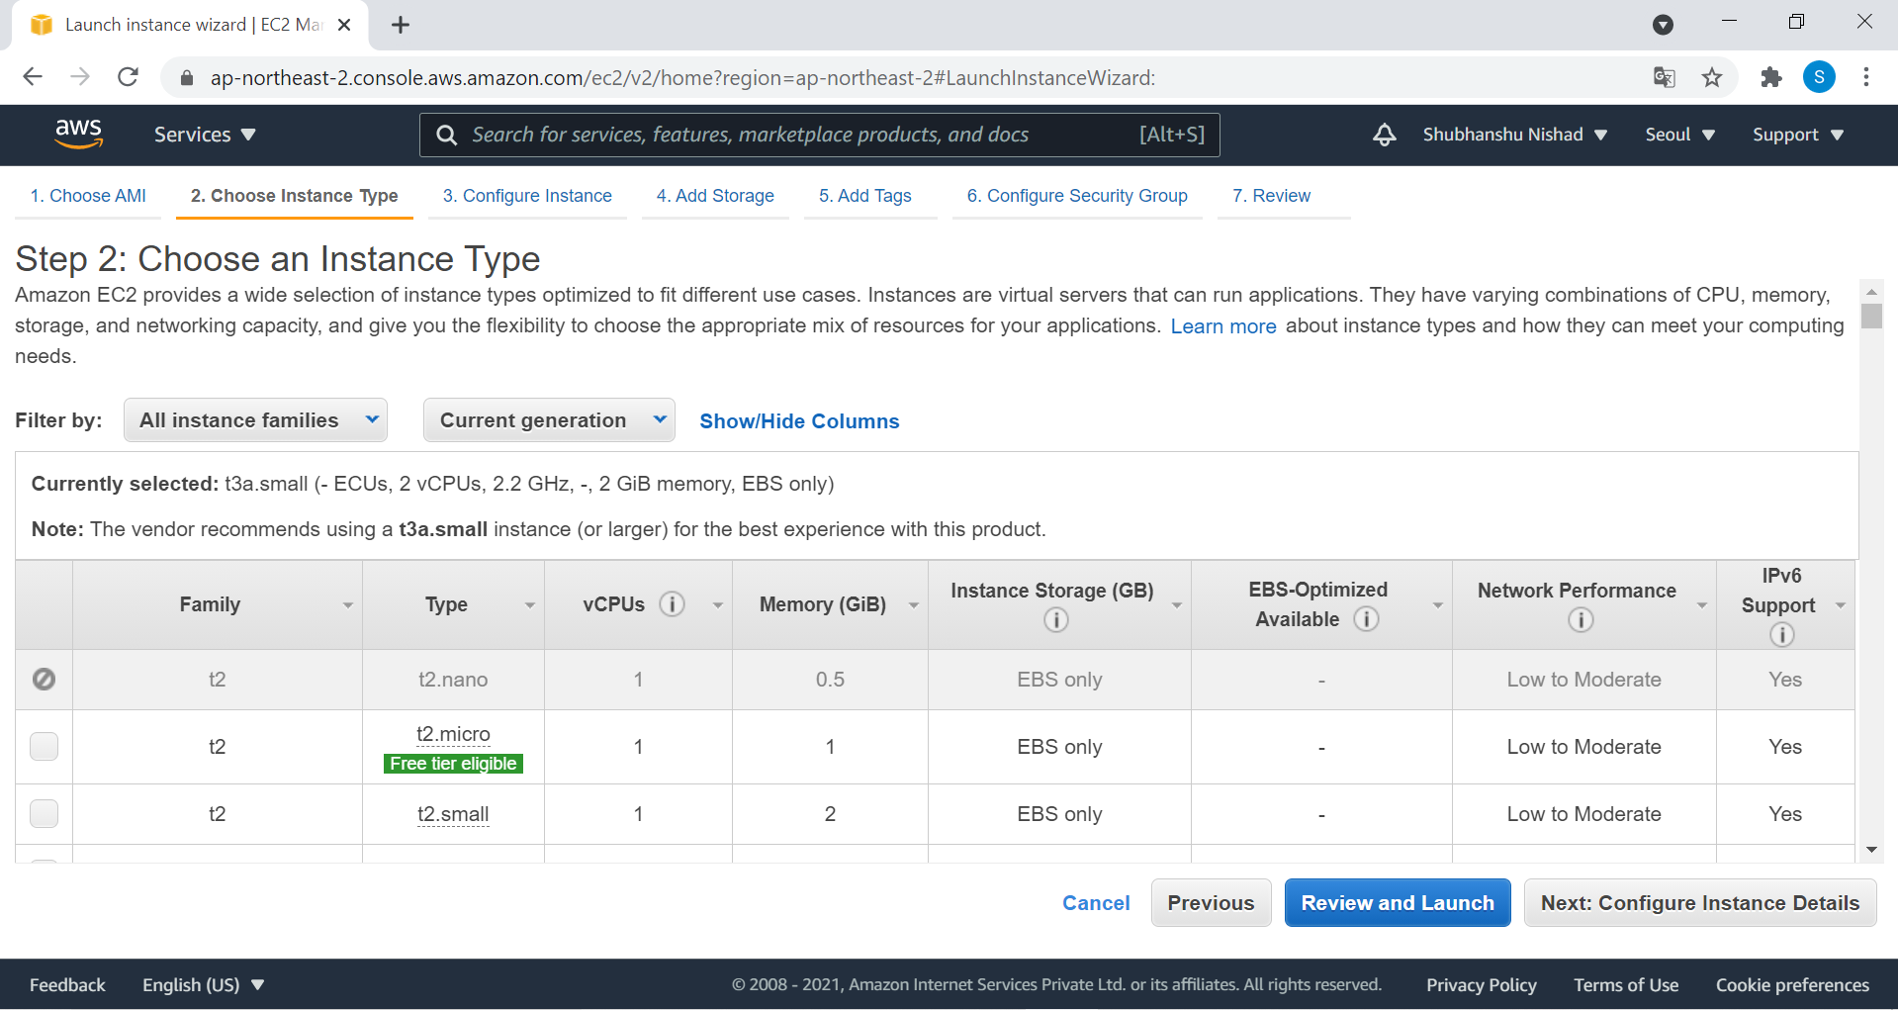
Click On this Button

Slide 14
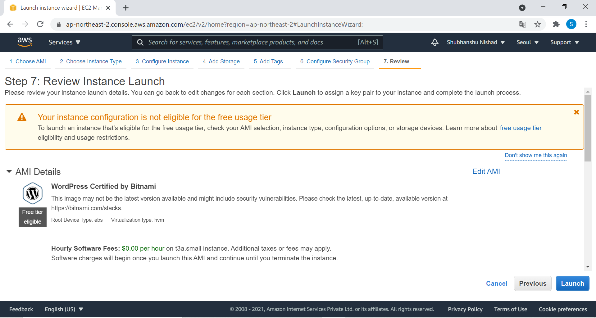
Click On Launch

Slide 15
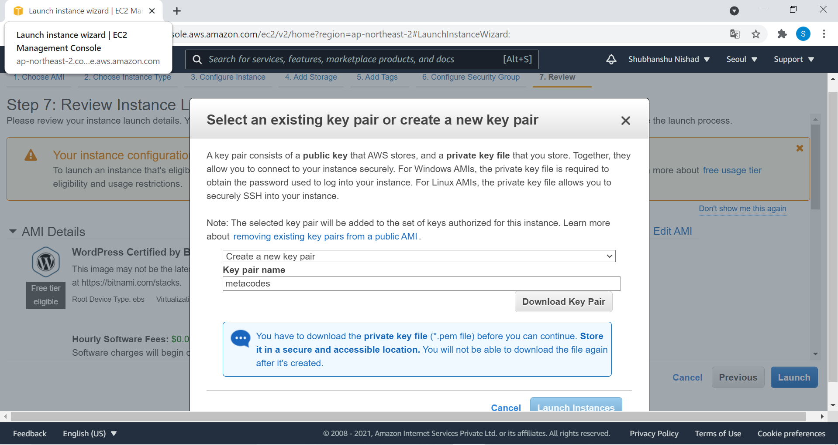
Choose Option Create a new key pair
Choose Any File Name
Click this button to download

Slide 16
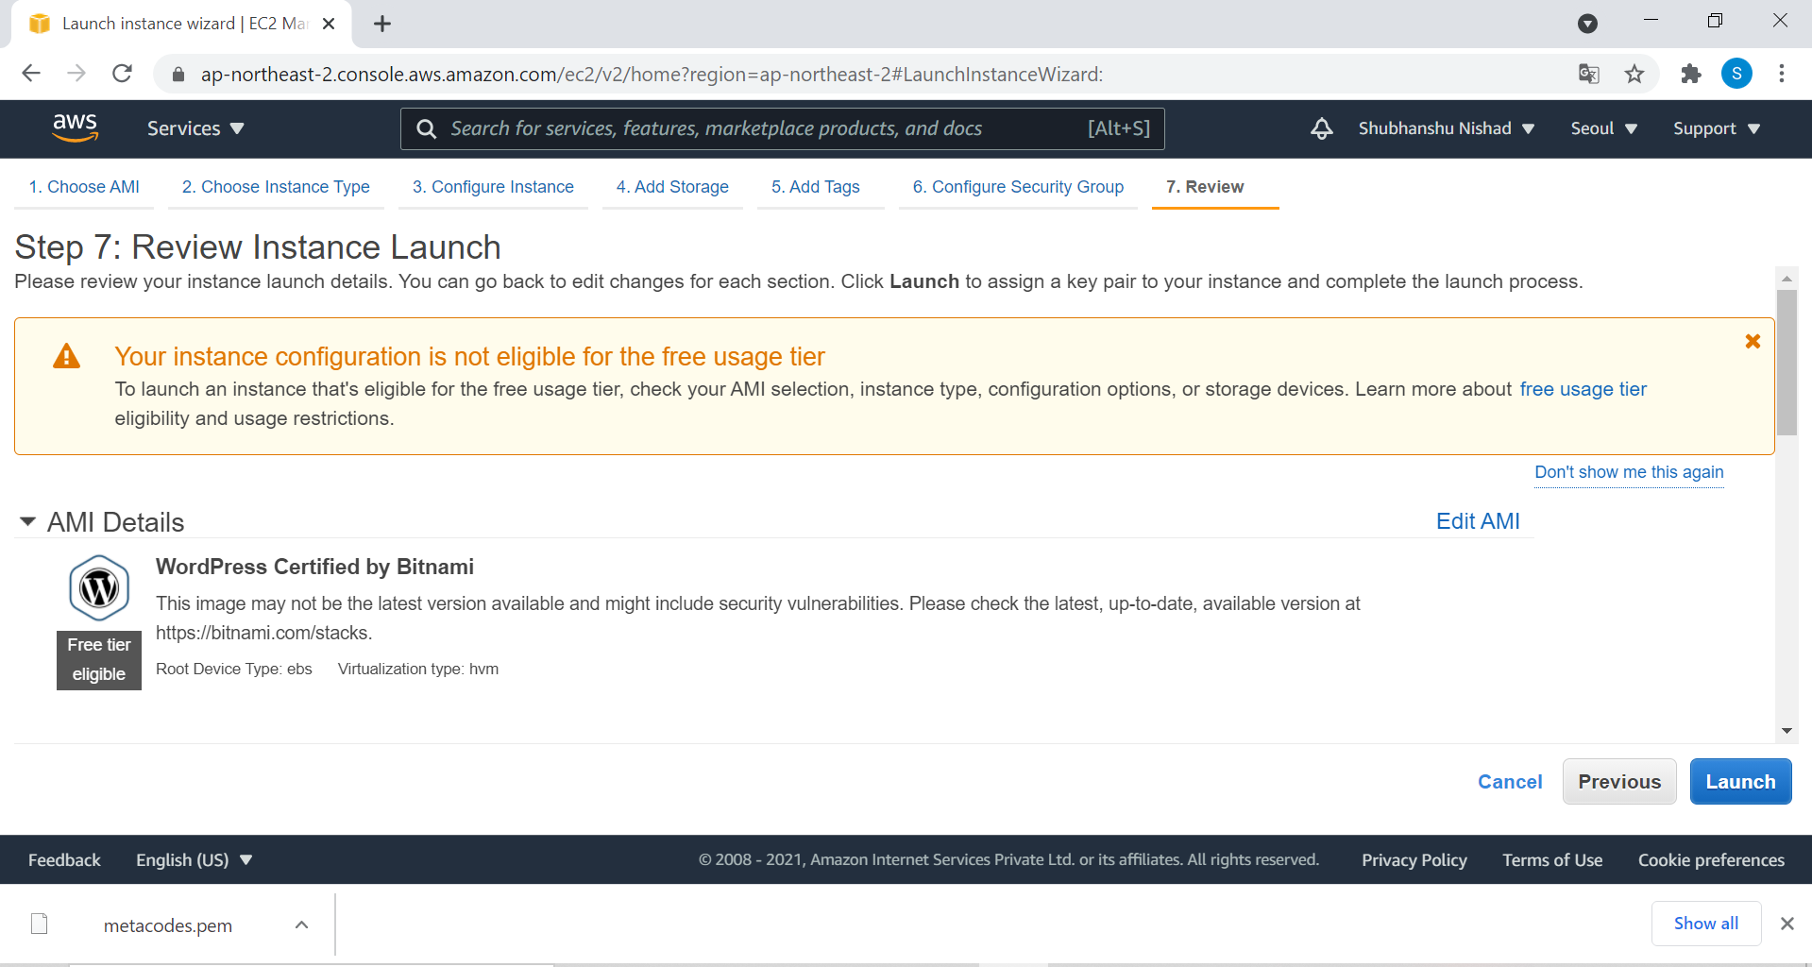
Click On Launch Button

Slide 17
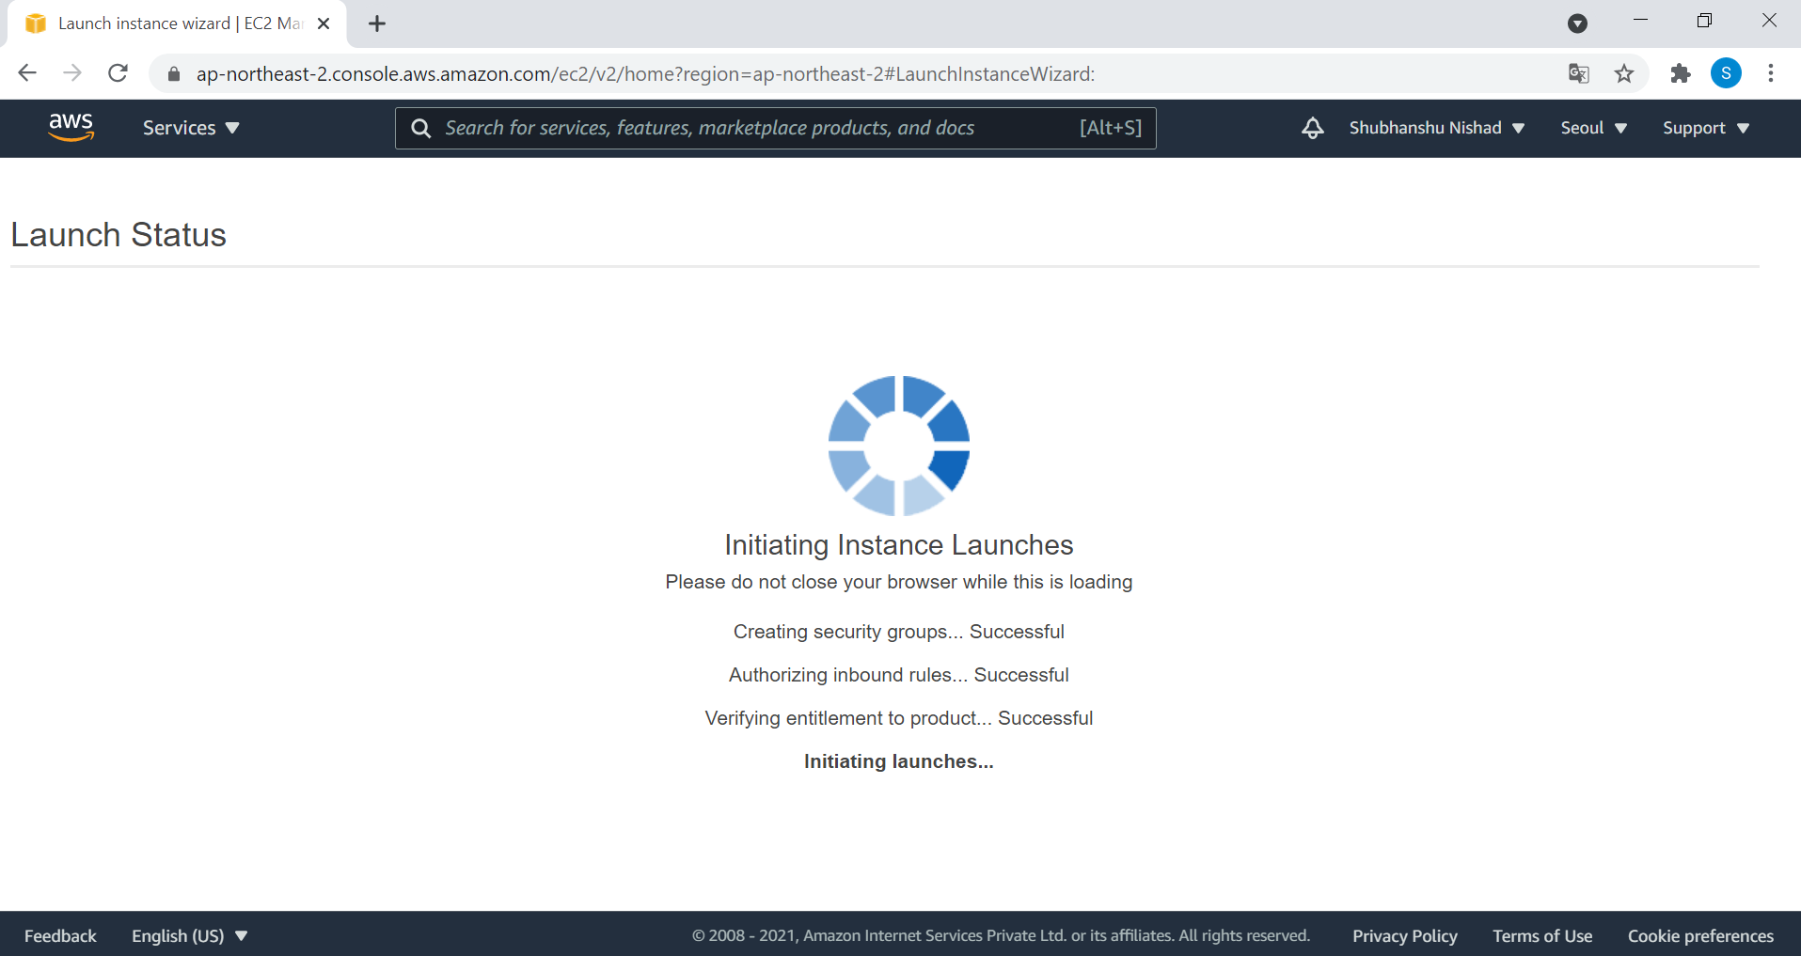
Your Instance is on process,
Wait few seconds

Slide 18
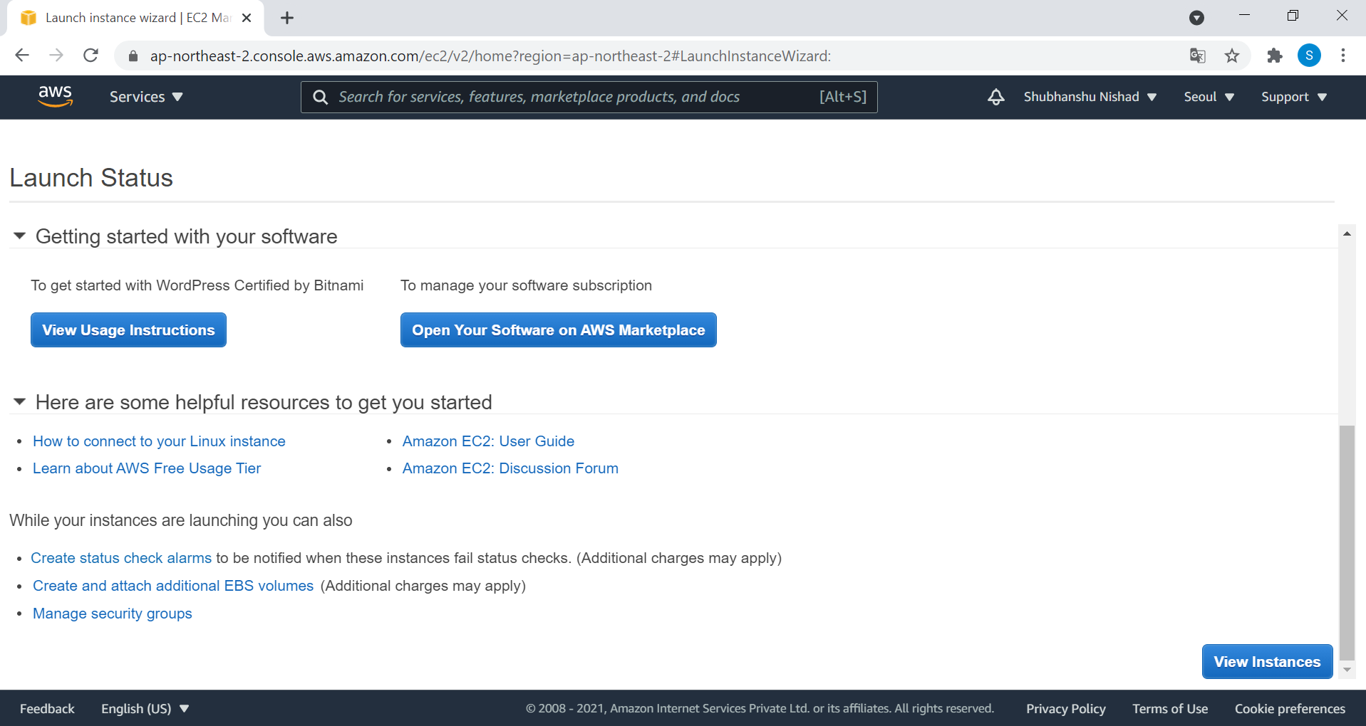
Scroll Down , Click On view Instances

Slide 19
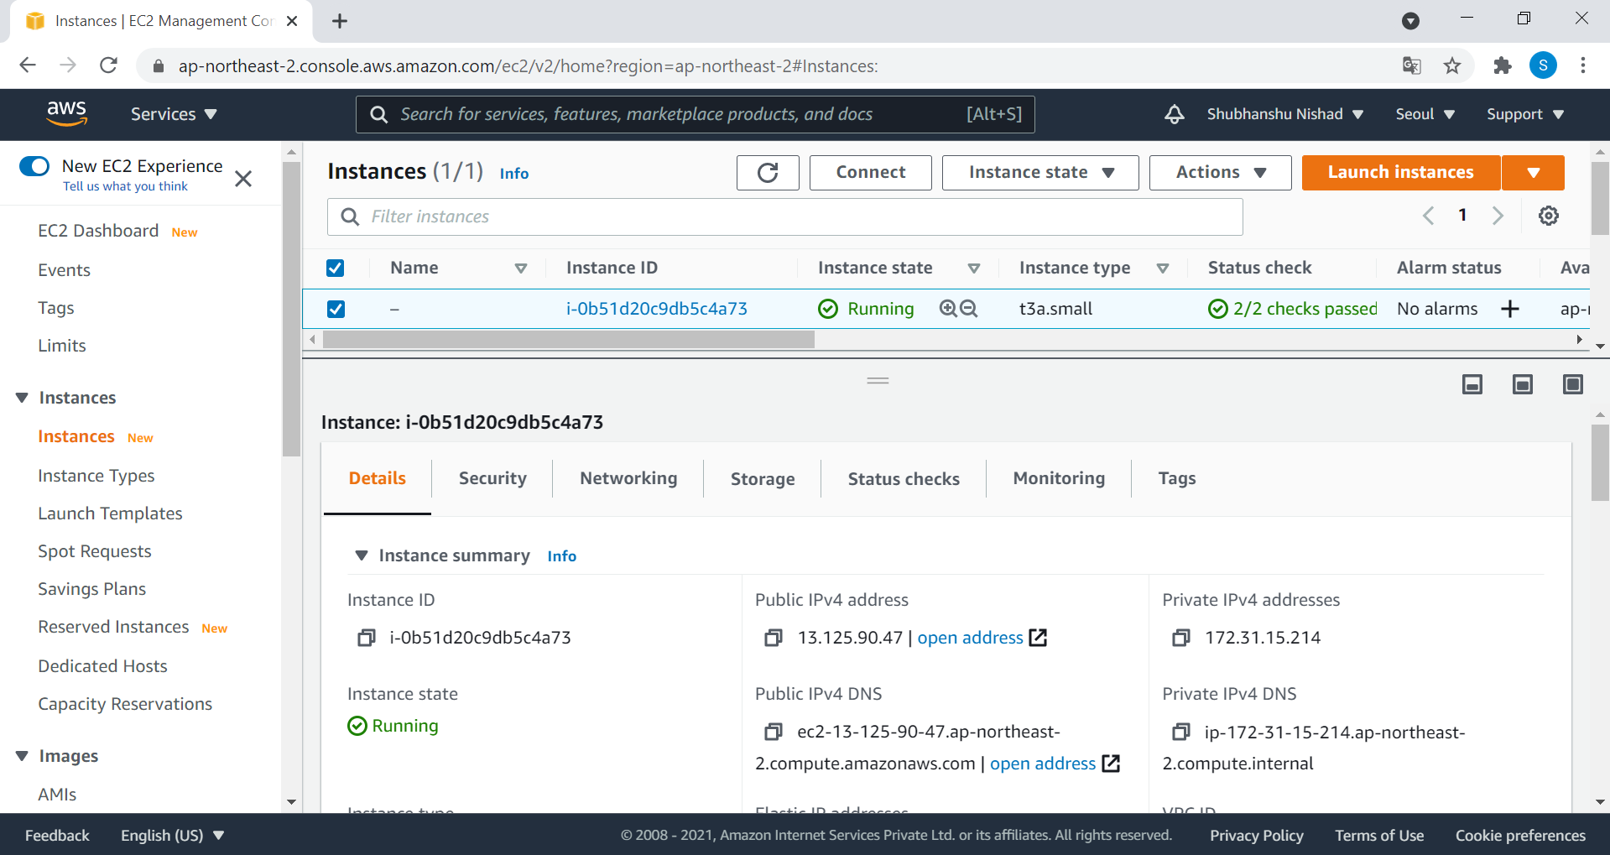
Tick ✔ on Box
Copy this IP Address

Slide 20
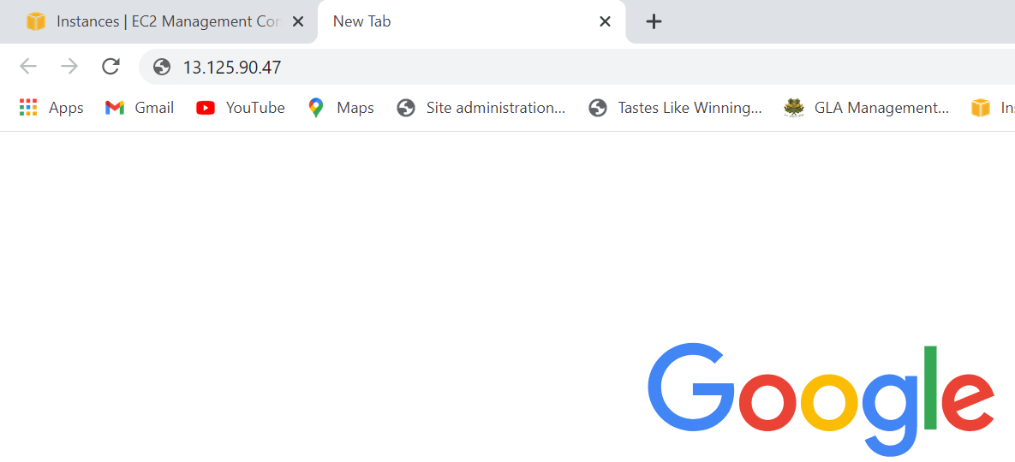
Paste Your Copied IP Address

Slide 21
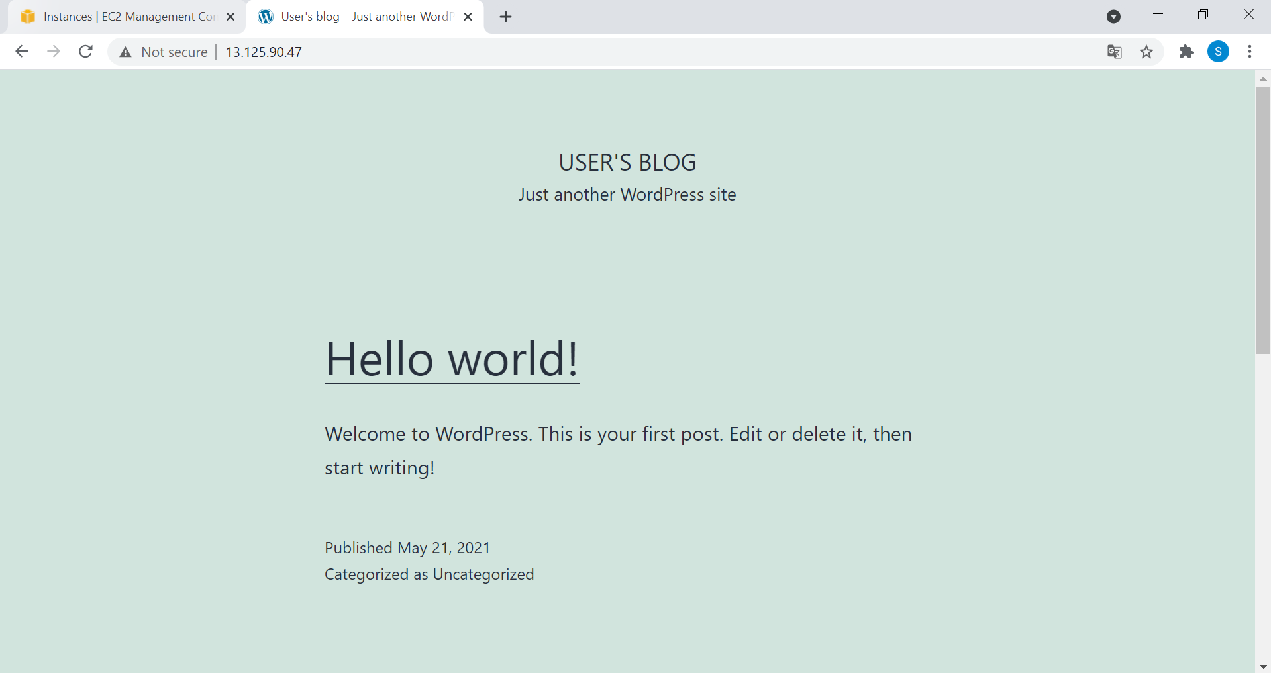
Congrats, You have hosted your first
Wordpress Website.
Now, its time to login in your admin panel

Slide 22
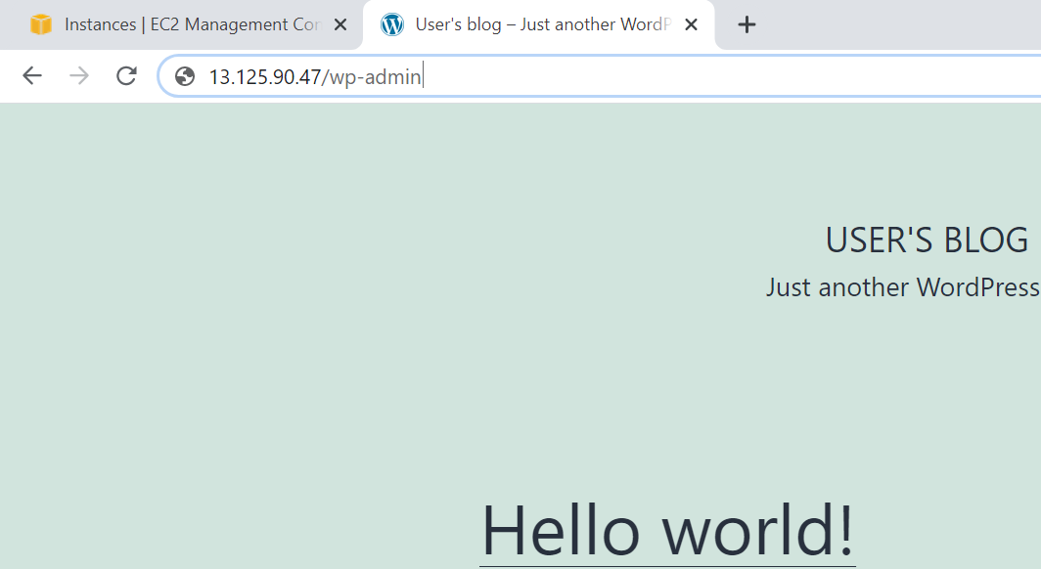
Type: Ip-address/wp-admin
Hits Enter

Slide 23
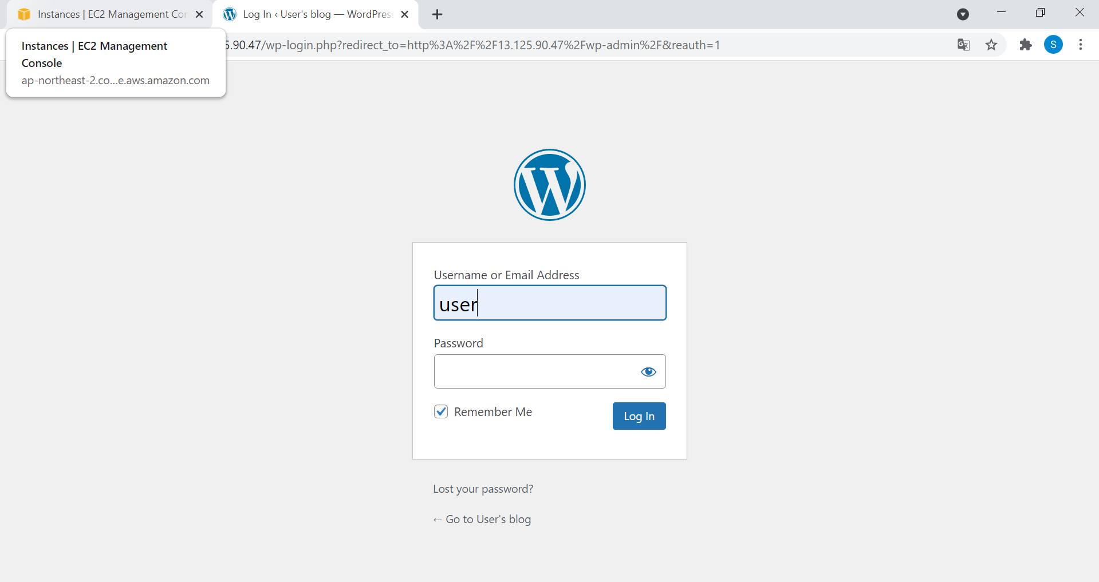
By Default Your Username is : user
Its time to get Your Password,
Open Your AWS TAB

Slide 24
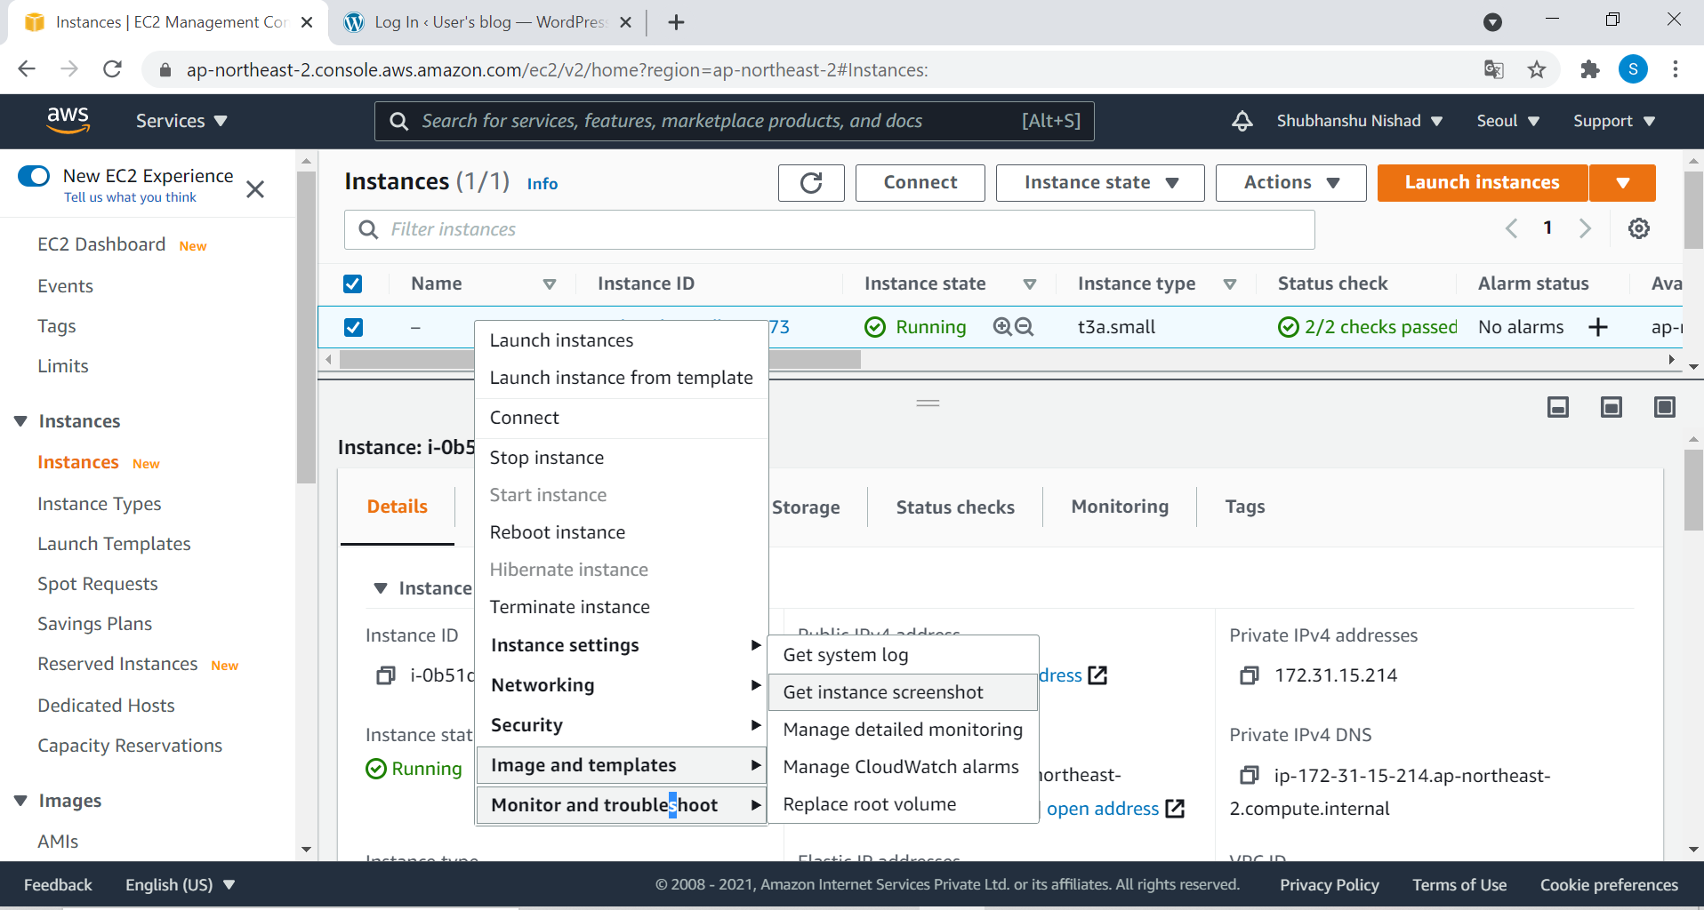
Choose last Option
Click On Get System Log

Slide 25
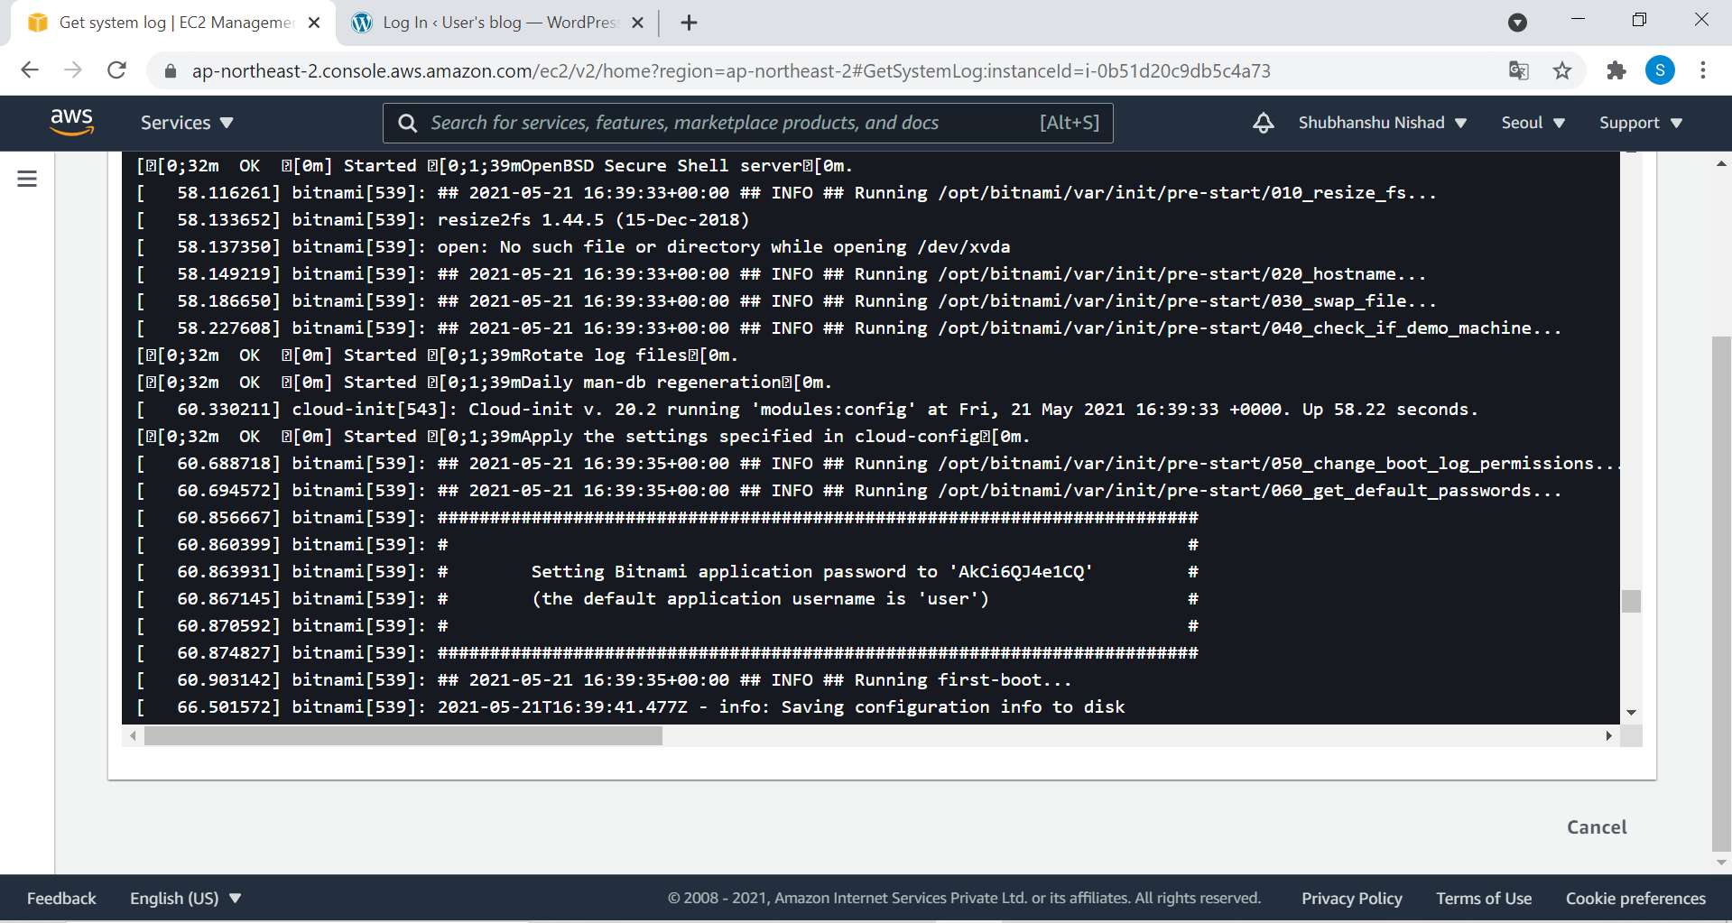
This is your password ,
Copy this …..

Slide 26
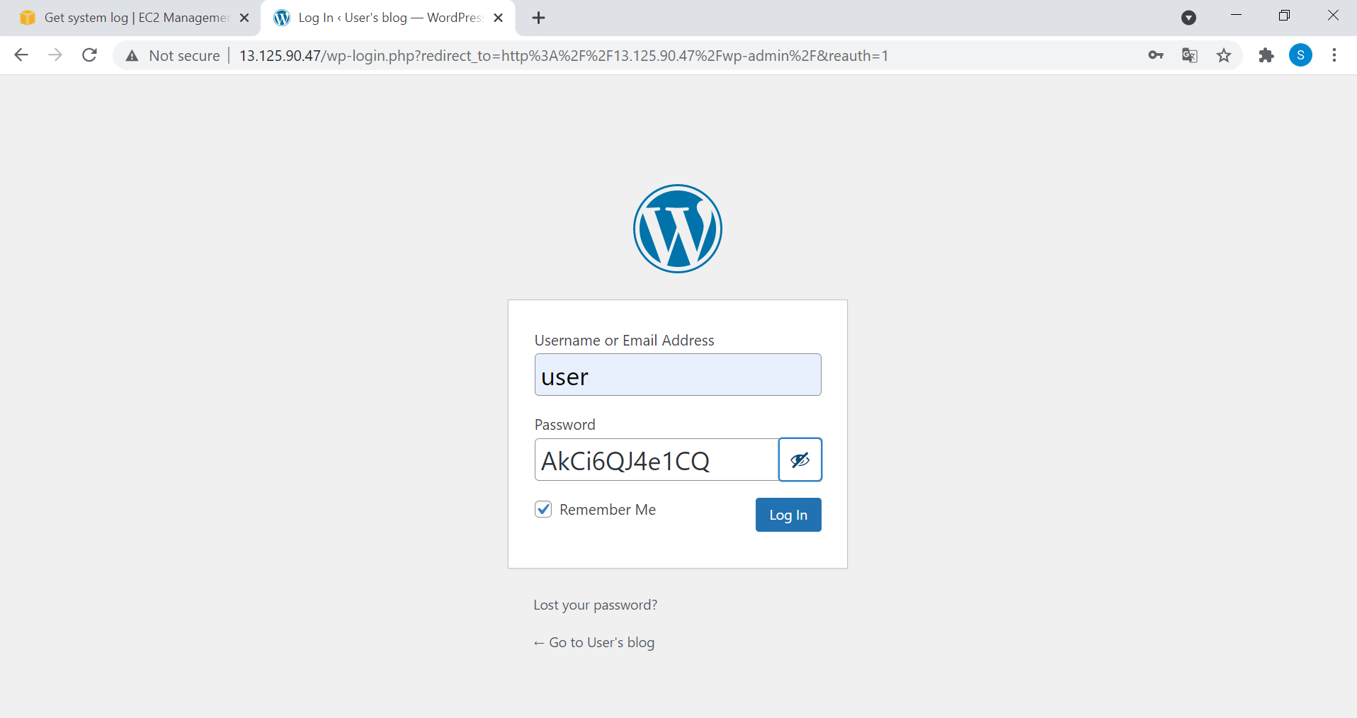
Login in your Account

Slide 27
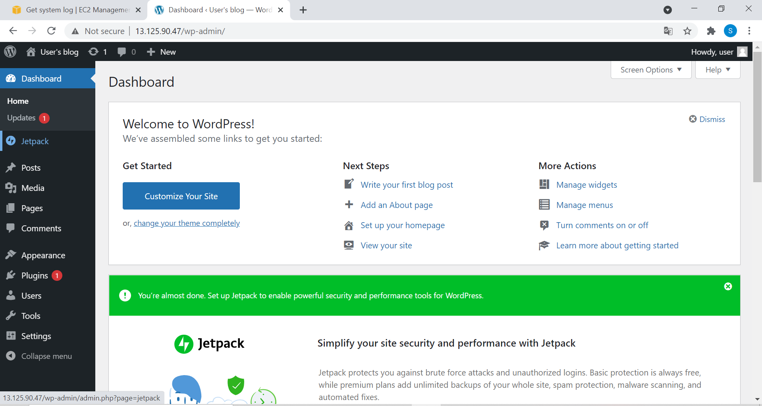
Congratulations, You have
finally hosted your website

Slide 28

Meta Educator
www.metaeducators.com

